Slide 1
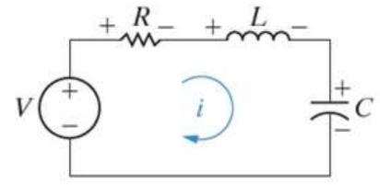
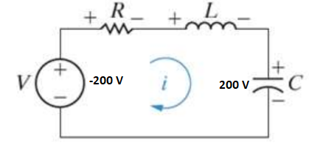

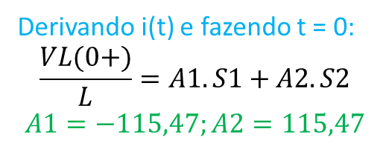
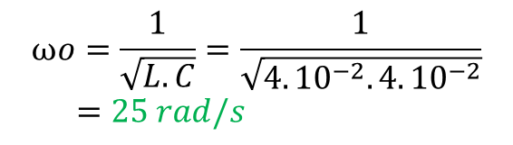
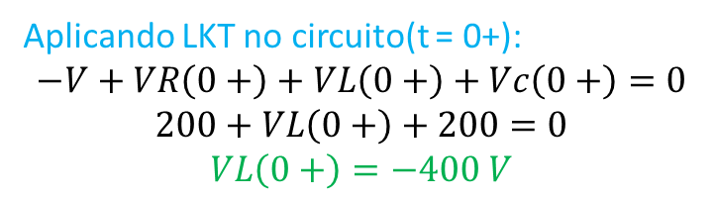
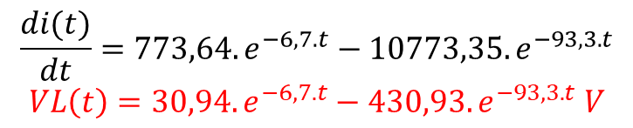
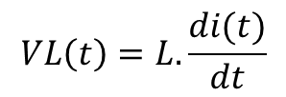
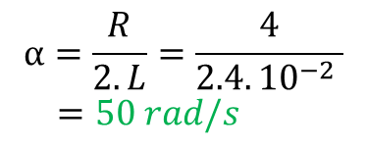
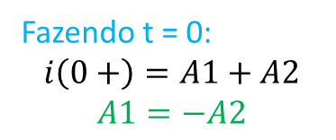
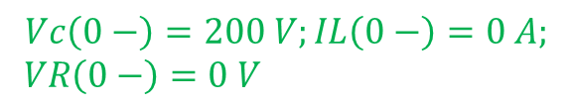
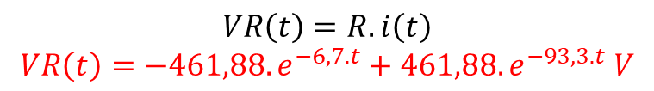

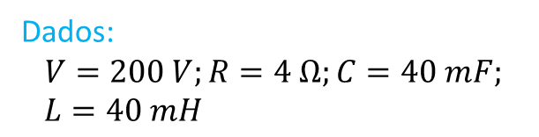
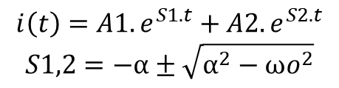
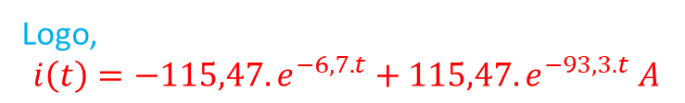
Dados:
$$V=200 V;R=4 Ω;C=40 mF;$$
$L=40 mH$
Fazendo t = 0:
$$i\left(0+\right)=A1+A2$$
$$A1=−A2$$
I) Argumentos para t < 0;
Aplicando LKT no circuito(t = 0+):
$$−V+VR\left(0+\right)+VL\left(0+\right)+Vc\left(0+\right)=0$$
$$200+VL\left(0+\right)+200=0$$
$$VL\left(0+\right)=−400 V$$
$$Vc\left(0−\right)=200 V;IL\left(0−\right)=0 A;$$
$VR\left(0−\right)=0 V$
Para t ≥ 0:
II) Determinar α e ωo;
Derivando i(t) e fazendo t = 0:
$$\frac{VL(0+)}{L}=A1.S1+A2.S2$$
$$A1=−115,47;A2=115,47$$
$$α=\frac{R}{2.L}=\frac{4}{2.4.{10}^{−2} }$$
$=50 rad/s$
$$ωo=\frac{1}{\sqrt{L.C}}=\frac{1}{\sqrt{4.{10}^{−2}.4.{10}^{−2}}}$$
$=25 rad/s$
Logo,
$$i\left(t\right)=−115,47.e^{−6,7.t}+115,47.e^{−93,3.t} A$$
IV) Determinar VR(t);
Como $α^{2}>{ωo}^{2}$, temos um
Superamortecimento.
$$VR\left(t\right)=R.i\left(t\right)$$
$$VR\left(t\right)=−461,88.e^{−6,7.t}+461,88.e^{−93,3.t} V$$
III) Determinar i(t);
V) Determinar VL(t);
$$i\left(t\right)=A1.e^{S1.t}+A2.e^{S2.t}$$
$$S1,2=−α±\sqrt{α^{2}−{ωo}^{2}}$$
$$VL\left(t\right)=L.\frac{di(t)}{dt}$$
$$\frac{di(t)}{dt}=773,64.e^{−6,7.t}−10773,35.e^{−93,3.t}$$
$$VL\left(t\right)=30,94.e^{−6,7.t}−430,93.e^{−93,3.t} V$$
$$S1=−6,7;S2=−93,3$$

Slide 2
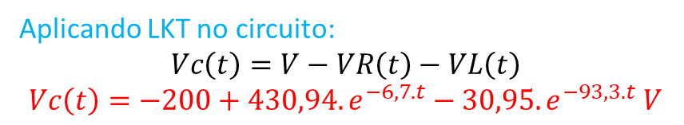
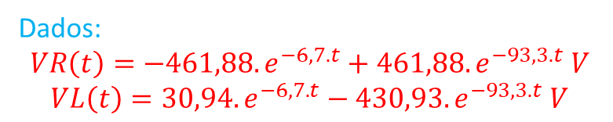
Dados:
$$VR\left(t\right)=−461,88.e^{−6,7.t}+461,88.e^{−93,3.t} V$$
$$VL\left(t\right)=30,94.e^{−6,7.t}−430,93.e^{−93,3.t} V$$
VI) Determinar Vc(t):
Aplicando LKT no circuito:
$$Vc\left(t\right)=V−VR\left(t\right)−VL\left(t\right)$$
$$Vc\left(t\right)=−200+430,94.e^{−6,7.t}−30,95.e^{−93,3.t} V$$
Para t ≥ 0:

